Slide 1
All about Data scientist Jobs
Andrew ID: yiyoul

Slide 2
PART I The Data Scientist Job Market - Overview

Slide 3
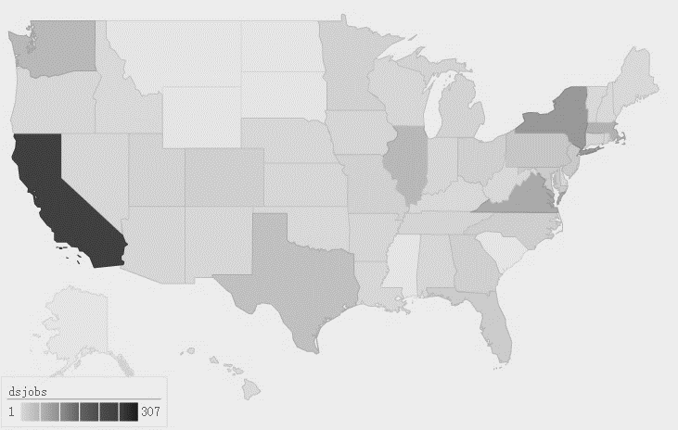
PART I The Data Scientist Job Market - Location
NY
110
CA
305
VA 80
Notes:
[('CA', 305), ('NY', 110), ('VA', 80), ('MA', 68), ('IL', 56)]
[('New York, NY', 93), ('San Francisco, CA', 72), ('Chicago, IL', 38), ('Seattle, WA', 35), ('Palo Alto, CA', 27), ('Boston, MA', 27), ('Washington, DC', 26), ('Mountain View, CA', 23), ('San Jose, CA', 23), ('Santa Clara, CA', 22)]

Slide 4

PART I The Data Scientist Job Market - Company
Notes:
Consulting [['Booz Allen Hamilton' '24'] ['KPMG' '24'] ['The Nielsen Company' '6'] ['IBM' '5'] ['CACI' '5'] ['Accenture' '4'] ['Apogee Integration, LLC' '4'] ['CGI' '4'] ['McKinsey & Company' '4'] ['Aspen Technology' '3'] ['DataRobot' '3']]
Technology [['Microsoft' '12'] ['Leidos' '6'] ['Teradata' '5'] ['Oracle' '5'] ['NVIDIA' '5'] ['Cisco Systems, Inc.' '5'] ['Intel' '4'] ['SAP' '4'] ['Xerox' '3'] ['Illinois Technology Association' '3'] ['Adobe' '3']]
Internet [['Facebook' '8'] ['Google' '7'] ['Netflix' '7'] ['Indeed Prime' '6'] ['Dropbox' '3']]
eCommerce [['Amazon Corporate LLC' '12'] ['Walmart eCommerce' '7'] ['Walmart' '4'] ['eBay' '4'] ['Groupon' '3'] ['TARGET' '3'] ['Magento' '3']]
Healthcare [['UnitedHealth Group' '7'] ['Aetna' '3'] ['Preventice Services, LLC' '3'] ['UnityPoint Health' '3'] ['GE Healthcare' '3']]
Finance [['Capital One' '8'] ['Morgan Stanley' '5'] ['OnDeck' '3']]
Telecommunications [['Verizon' '17']]
GovernmentService [['Mitre Corporation' '4'] ['SAIC' '4'] ['Central Intelligence Agency' '3']]
HR [['Workbridge Associates' '8'] ['Faraday Future, Inc.' '4'] ['Selby Jennings' '4']]
Transportation [['Uber' '4']]

Slide 5
PART II A Snapshot
of
Data Skillset - Degree
Notes:
['data+scientist', 'data+engineer', 'data+analyst', 'business+analyst', 'marketing+analyst', 'machine+learning'] ############################################################# bachelor 24 20 25 37 15 7 masters 114 31 30 16 9 38 phd 236 28 8 0 1 161 computerscience 118 251 80 66 9 123 mathematics 78 38 26 5 14 38 quantitative 344 78 192 64 128 86 kaggle 8 4 0 0 0 2

Slide 6
PART II A Snapshot
of
Data Skillset
- Skills

Slide 7
PART II A Snapshot
of
Data Skillset
- ML& Stat

Slide 8

PART III The Data
People
&
Their
Titles
Type I: Data Modeler
Well-Rounded
Phd, CS/ Math background
Python, Java, C++
NLP , predictive analysis, Deep learning
Big data, Cloud Computing
Visualization
80%
Machine Learners
40%
Data Scientists
Notes:
Type I
machinelearning
programming
statistics
communication
datascience
bigdata
phd
computerscience
python
nlp
predictive
deeplearning
visualization
cloud
optimization

Slide 9

PART III The Data
People
&
Their
Titles
Type II: Big Data Guy
All about Big Data
CS Background
Java
Hadoop, spark
Database, Data warehouse, NoSql
Data processing
Distributed system, Architecture, Infrastructure
90%
Data Engineers
10%
Data Scientists

Slide 10
PART III The Data
People
&
Their
Titles
Type III: The Analyst
Provide Insight from Analysis
Quantitative Background
SAS, Python
Database
Machine Learning/ Data Mining
Visualization
Recommendations & Communication
50%
Data Scientists
10%
Machine Learners

Slide 11
Thank YOU

